Slide 1

7th Grade Accelerated Math
Unit 2, Lesson 3 Cube Values Volume 1, pg. 74

Slide 2


Benchmark
MA.8.AR.2.3
Given an equation in the form of 𝑥² = 𝑝 and 𝑥³ = 𝑞, where 𝑝 is a whole number and 𝑞 is an integer, determine the real solutions.
volume 1, pg. 74

Slide 3
Integrated Mathematical Thinking and Reasoning Standards
MA.K12.MTR.1.1 Actively participate in effortful learning both individually and collectively.
MA.K12.MTR.2.1 Demonstrate understanding by representing problems in multiple ways.
MA.K12.MTR.4.1 Engage in discussions that reflect on the mathematical thinking of self and others.
MA.K12.MTR.5.1 Use patterns and structure to help understand and connect mathematical concepts.
volume 1, pg. 74

Slide 4

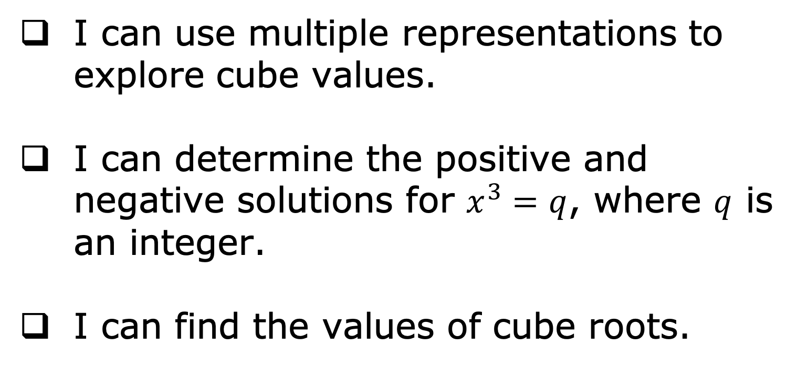
Learning Targets
I can use multiple representations to explore cube values.
I can determine the positive and negative solutions for $x^{3}=q$, where $q$ is an integer.
I can find the values of cube roots.
volume 1, pg. 74

Slide 5

Warm-Up
volume 1, pg. 74

Slide 6
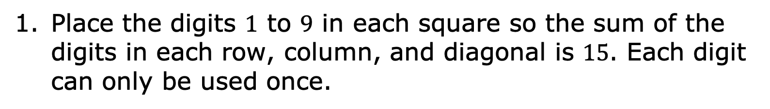
2.3.1 Warm-Up: Magic Square
Place the digits $1$ to $9$ in each square so the sum of the digits in each row, column, and diagonal is $15$. Each digit can only be used once.
volume 1, pg. 74

Slide 7

Exploration
volume 1, pg. 75

Slide 8

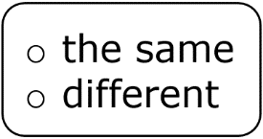
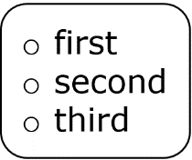
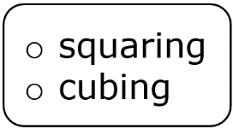
2.3.2 Exploration: Volume of Cubes
The volume of a cube can be found by multiplying the length by the width by the height. Volume is measured in cubic units.
Work with your partner to complete the following.
Complete the statements.
The length, width, and height of a cube have
measure(s). Therefore, the volume of a cube can be found
by taking one side length to the power, which is also known as the side length.
volume 1, pg. 75

Slide 9
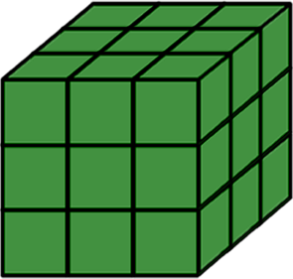
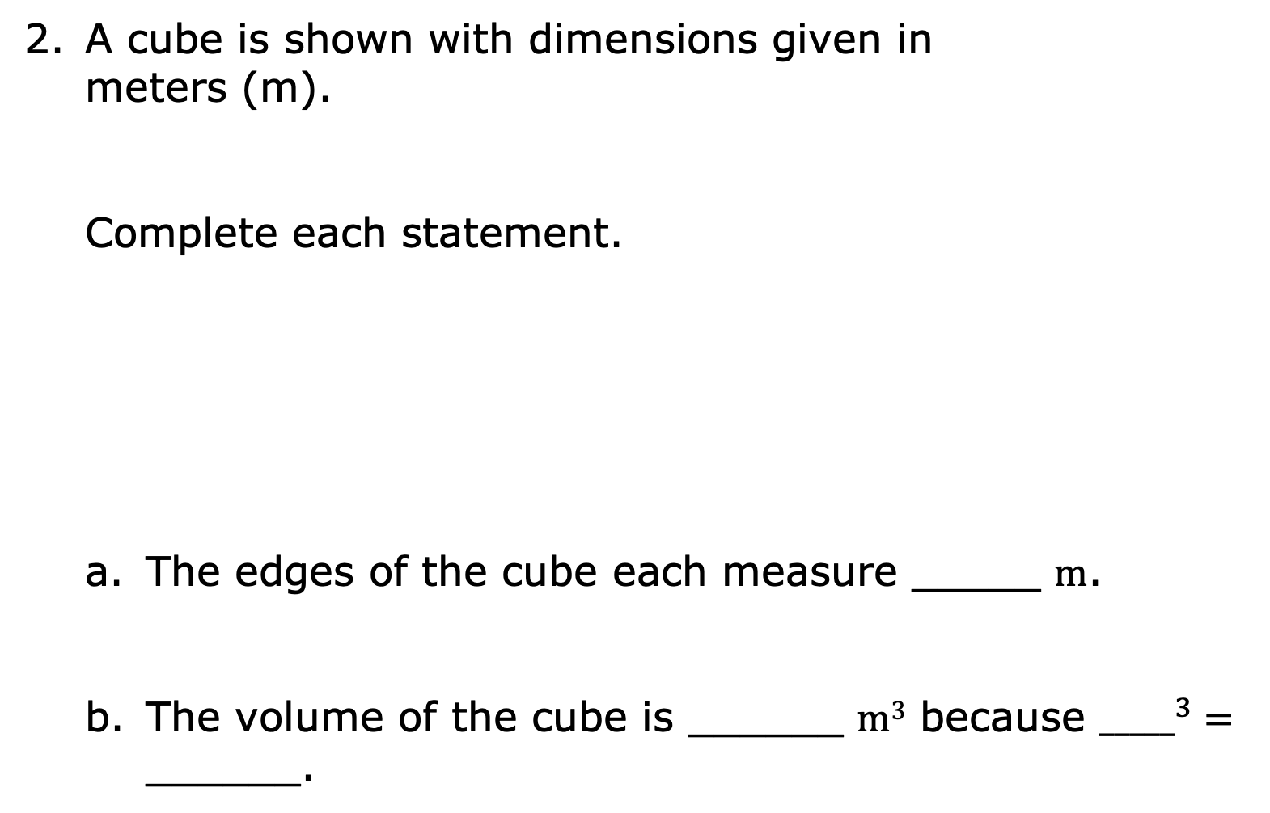
A cube is shown with dimensions given in meters (m).
Complete each statement.
The edges of the cube each measure _____ m.
The volume of the cube is ______ m³ because ${_____}^{3}=$ ______.
3 m
3 m
3 m
volume 1, pg. 75

Slide 10
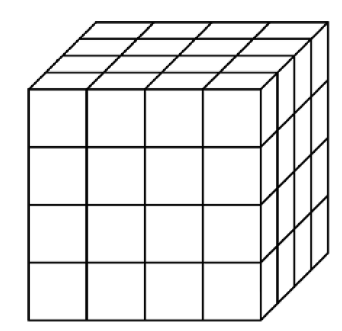

A cube is shown, where each gridline measures $1$ unit.
Label the measures of the length, width, and height of the cube.
What is the volume of the cube?
volume 1, pg. 76

Slide 11
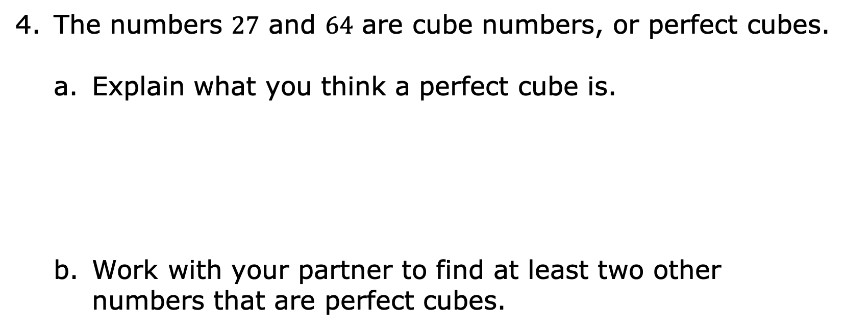
The numbers $27$ and $64$ are cube numbers, or perfect cubes.
Explain what you think a perfect cube is.
Work with your partner to find at least two other numbers that are perfect cubes.
volume 1, pg. 76

Slide 12

Bring It Together
volume 1, pg. 76

Slide 13

2.3.3 Bring It Together: Perfect Cubes
Discuss with your partner the similarities and differences between square numbers and cube numbers. Then, summarize your discussion in the table.
Similarities | Differences
volume 1, pg. 76

Slide 14
Exploration
volume 1, pg. 77

Slide 15
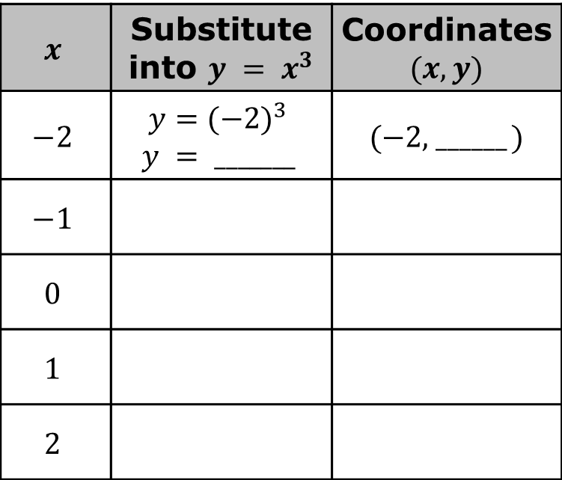
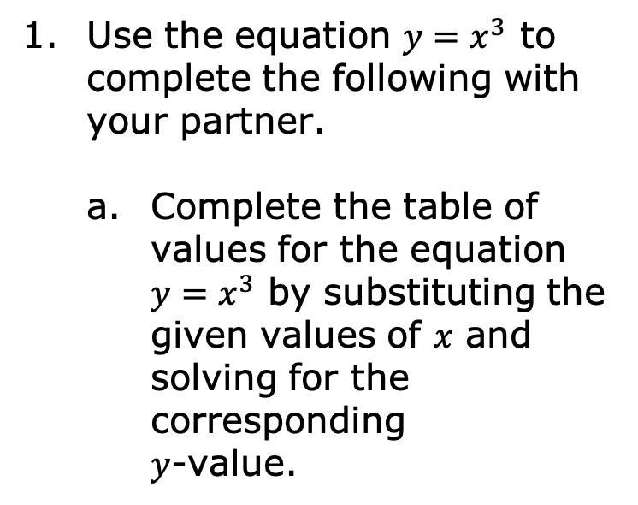
2.3.4 Exploration: Cube Values on the Coordinate Plane
Use the equation $y=x^{3}$ to complete the following with your partner.
Complete the table of values for the equation $y=x^{3}$ by substituting the given values of $x$ and solving for the corresponding $y$-value.
$$x$$ | Substitute into $y = x^{3}$ | Coordinates $(x, y)$
$$−2$$ | $$y={(−2)}^{3}$$ $$y = _______$$ | ($−2$, ______ )
$$−1$$
$$0$$
$$1$$
$$2$$
The $y$-values are cube numbers. What do you notice about the $y$-values?
volume 1, pg. 77

Slide 16
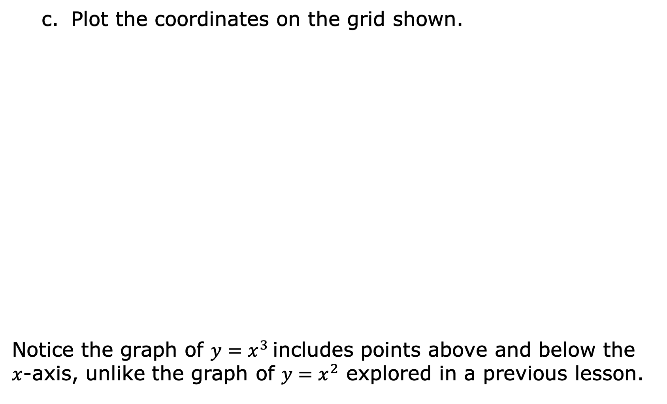
Plot the coordinates on the grid shown.
Notice the graph of $y=x^{3}$includes points above and below the $x$-axis, unlike the graph of $y=x^{2}$ explored in a previous lesson.
volume 1, pg. 77

Slide 17

Guided Instruction
volume 1, pg. 78

Slide 18
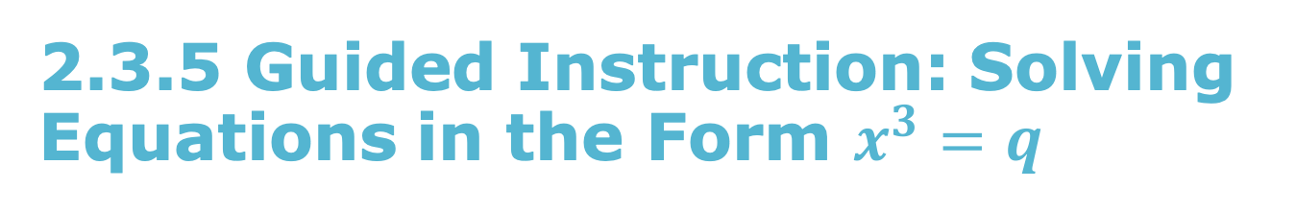
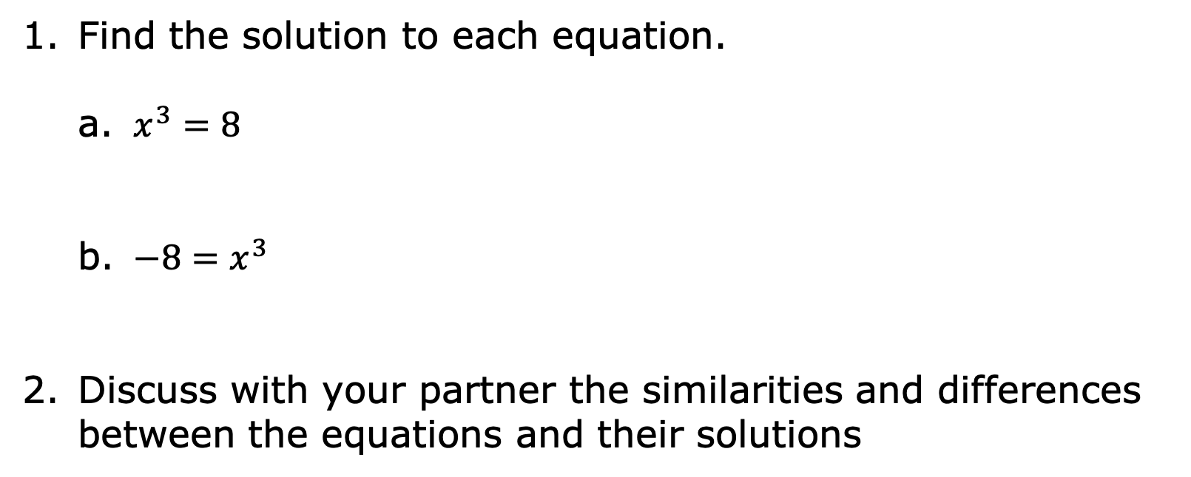
2.3.5 Guided Instruction: Solving Equations in the Form $x^{3}=q$
Find the solution to each equation.
$x^{3}=8$
$−8=x^{3}$
Discuss with your partner the similarities and differences between the equations and their solutions
volume 1, pg. 78

Slide 19
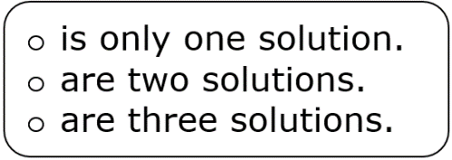
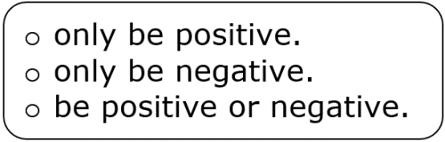
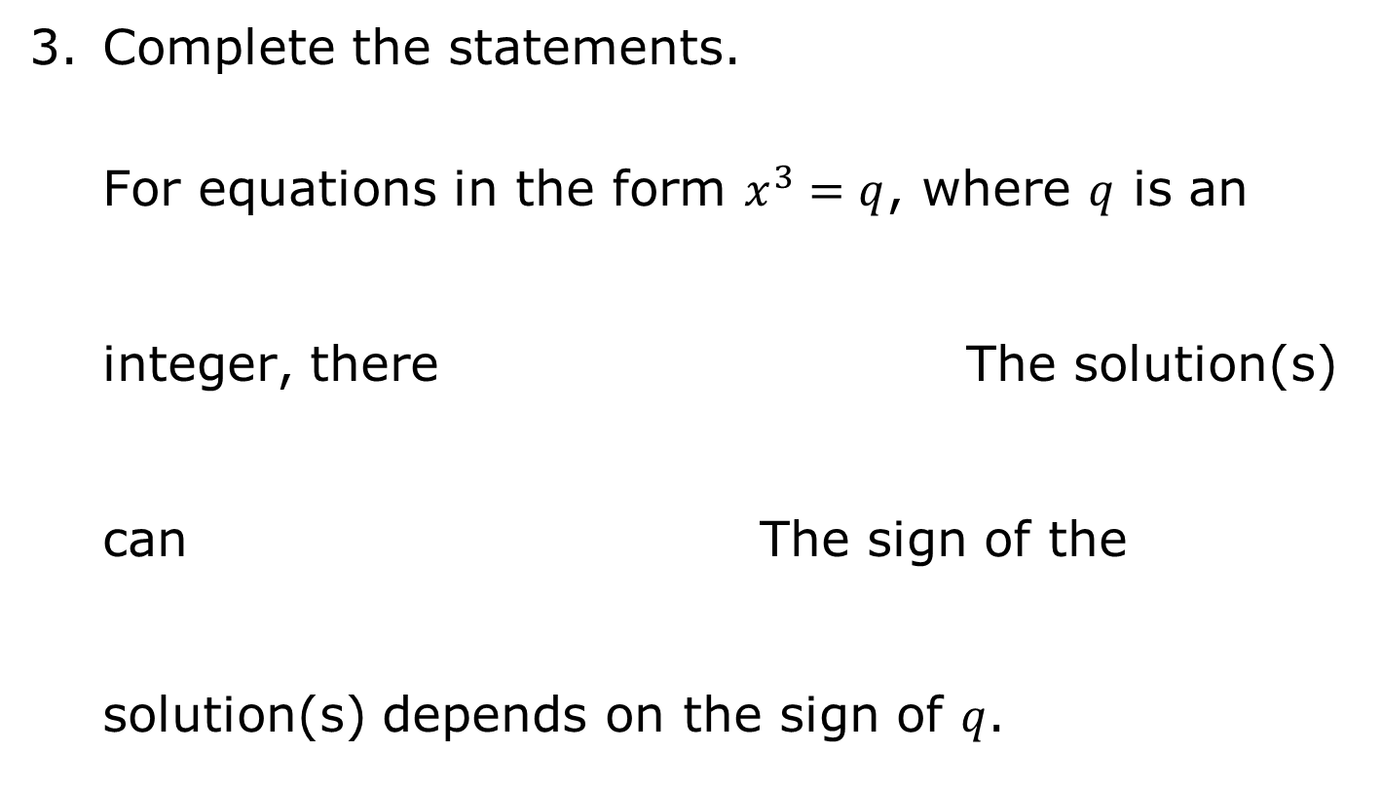
Complete the statements.
For equations in the form $x^{3}=q$, where $q$ is an integer, there The solution(s) can The sign of the solution(s) depends on the sign of $q$.
volume 1, pg. 78

Slide 20
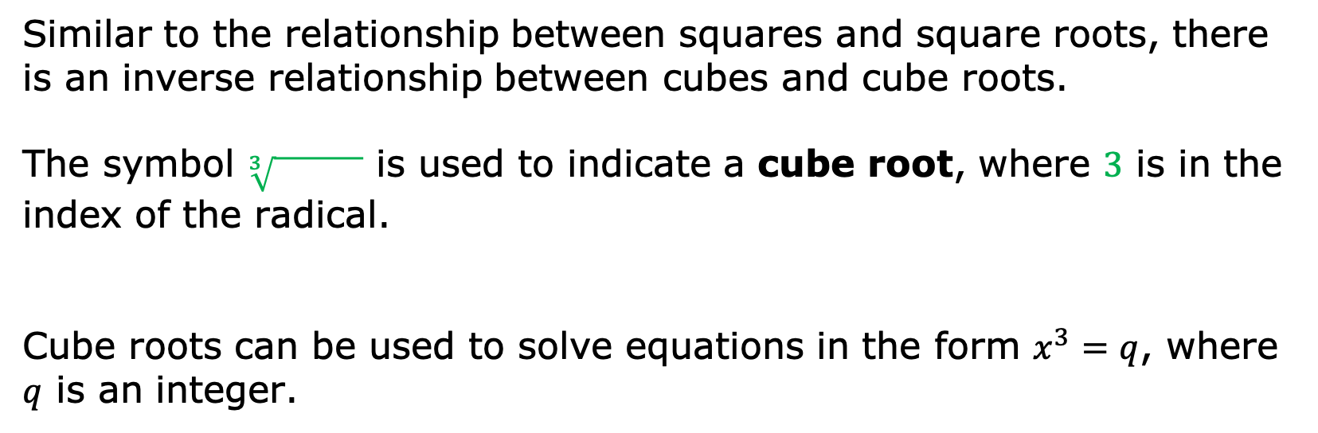
Similar to the relationship between squares and square roots, there is an inverse relationship between cubes and cube roots.
The symbol $\sqrt[3]{ }$ is used to indicate a cube root, where $3$ is in the index of the radical.
Cube roots can be used to solve equations in the form $x^{3}=q$, where $q$ is an integer.
volume 1, pg. 78

Slide 21
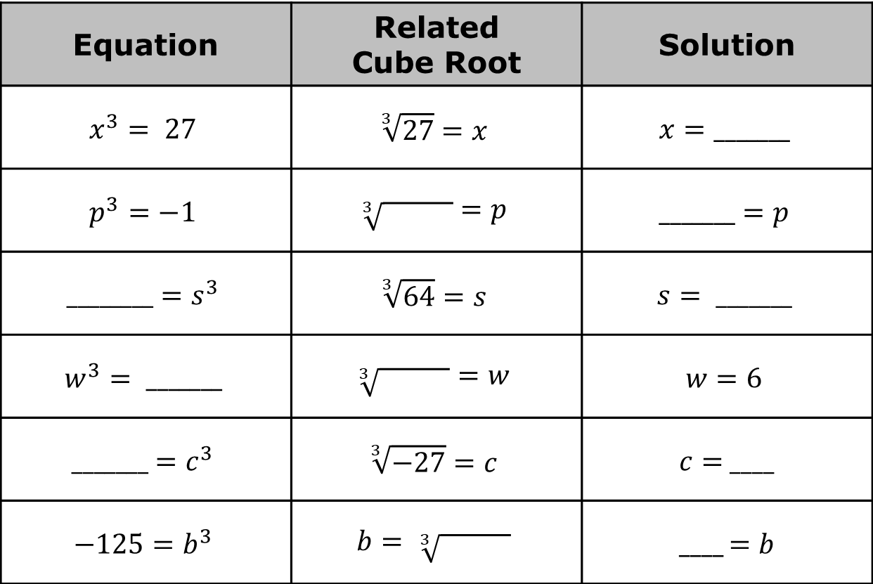
Complete the table for each equation.
Equation | Related Cube Root | Solution
$$x^{3}= 27$$ | $$\sqrt[3]{27}=x$$ | $$x=_______$$
$$p^{3}=−1$$ | $$\sqrt[3]{ }=p$$ | $$_______=p$$
$$________=s^{3}$$ | $$\sqrt[3]{64}=s$$ | $$s= _______$$
$$w^{3}= _______$$ | $$\sqrt[3]{ }=w$$ | $$w=6$$
$$_______=c^{3}$$ | $$\sqrt[3]{−27}=c$$ | $c=$ ____
$$−125=b^{3}$$ | $$b= \sqrt[3]{ }$$ | ____ $=b$
volume 1, pg. 78

Slide 22

Wrap-Up
volume 1, pg. 79

Slide 23
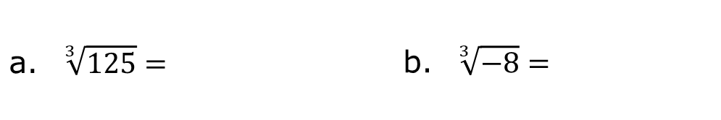

2.3.6 Wrap-Up: Ticket Out the Door
Find the value of each of the following.
Solve each equation.
$w^{3}=−64$
$1=k^{3}$
$\sqrt[3]{125}=$ |  | $\sqrt[3]{−8}=$
volume 1, pg. 79

